Slide 1
Minimum Spanning Tree (MST)

Slide 2
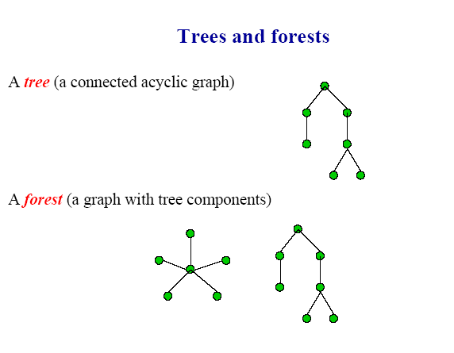

Slide 3
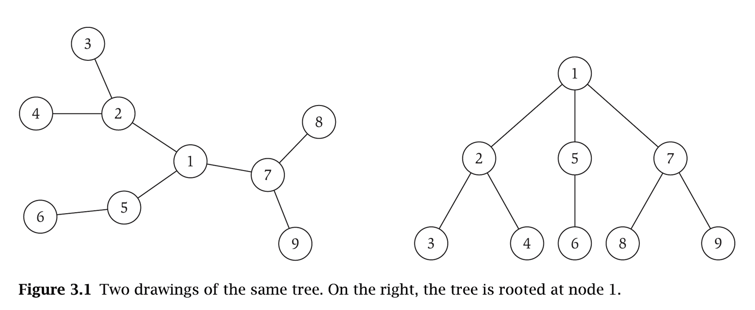
Trees
An undirected graph is a tree if it is connected and does not contain a cycle.

Slide 4
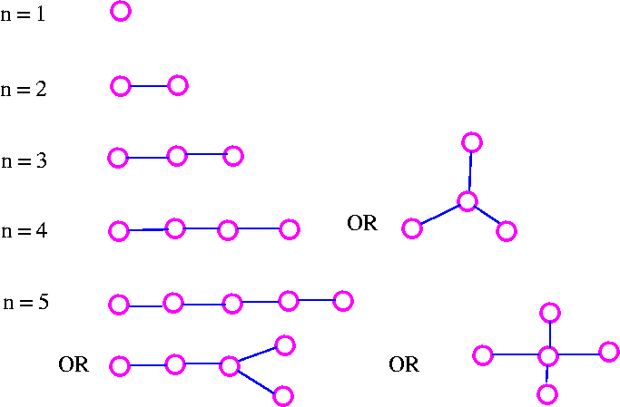
For example

Slide 5
A leaf (or pendant vertex) is a vertex of degree 1.
A spanning subgraph of G is a subgraph with vertex
set V (G).
A spanning tree is a spanning subgraph which is a
tree.

Slide 6
Rooted Trees
Given a tree T, choose a root node r and orient each edge away from r.
Application: Models hierarchical structure.
root r
parent of v
v
child of v
a tree
the same tree, rooted at 1

Slide 7
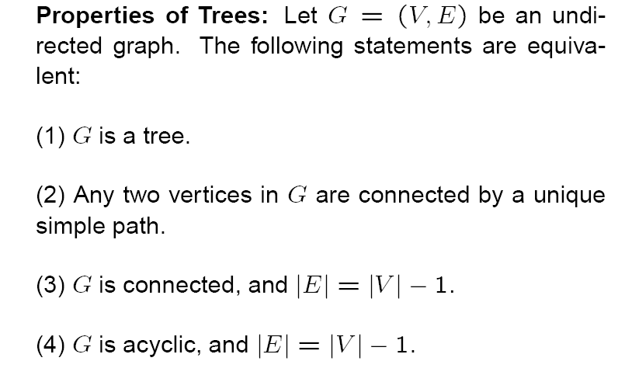
(5) G is connected and each edge is a bridge.
(6) G contains no cycles, but the addition of any new edge creates exactly one cycles.

Slide 8
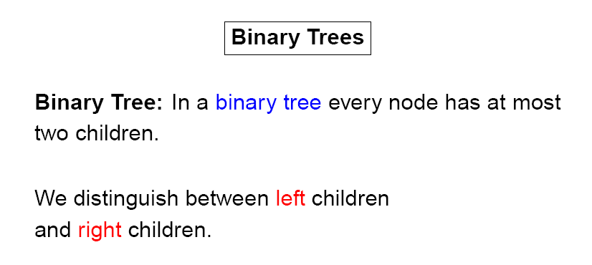
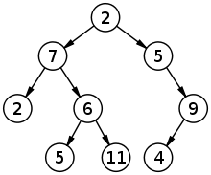
A simple binary tree of size 9 and height 3, with a root node whose value is 2. The above tree is neither a sorted nor a balanced binary tree

Slide 9
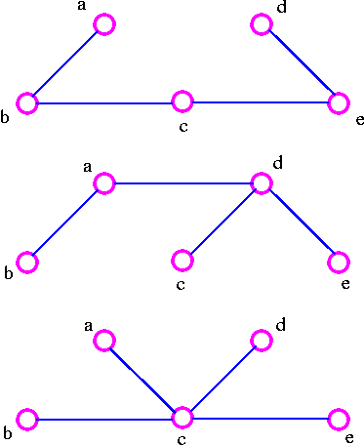
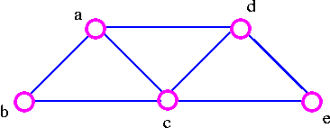
Spanning Trees
Let G be a connected graph. A spanning tree in G is a subgraph of G that includes all the vertices of G and is also a tree. The edges of the trees are called branches.
For example, consider the following graph G
The three spanning trees G are:

Slide 10
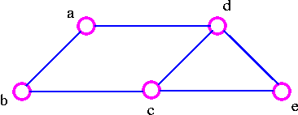
We can find a spanning tree systematically by using either of two methods.
Cutting-down Method
Start choosing any cycle in G.
Remove one of cycle's edges.
Repeat this procedure until there are no cycle left.
For example, given the graph G
1. We remove the edge ac which destroy the cycle adca in the above graph and we get

Slide 11
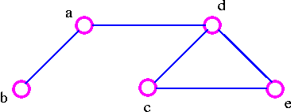
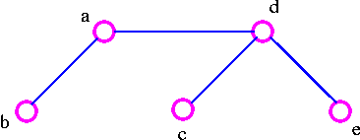
2. We remove the edge cb, which destroy the cycle adcba in the above graph and we get
3. We remove the edge ec, which destroy the cycle decd in the above graph and thus obtained the following spanning tree.

Slide 12
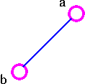
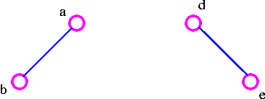
Building-up Method
Select edges of G one at a time in such a way that no cycles are created.
Repeat this procedure until all vertices are included.
For example, for the following graph G
1. Choose the edge ab
2. Next choose the edge de as follows:

Slide 13
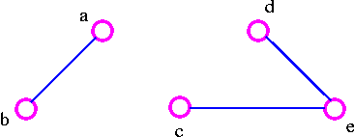
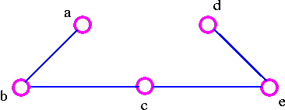
3. After that choose the edge ec as follows:
4. Finally, we choose the edge cb and thus obtain the following spanning tree.

Slide 14
Theorem A graph is connected if and only if it has a spanning tree.
Proof:
Let G be a connected graph. Delete edges from G that are not bridges until we get a connected subgraph H in which each edge is a bridge. Then H is a spanning tree. On the other hand, if there is a spanning tree in G, there is a path between any pair of vertices in G; thus G is connected.

Slide 15
Minimum Spanning Trees
A network (directed network) is a graph (digraph) where the edges (arcs) have been assigned non-negative real numbers. The numbers that have been assigned are called weights.
Definition: A minimum spanning tree in a network is a spanning tree of the underlying graph which has the smallest sum of weights amongst all spanning trees.
Example: Suppose that the vertices of a graph represent towns and the edges of the graph are roads between these towns. Label each edge with the distance between the towns. If, in this network, it is desired to run telephone wires along the roads so that all the towns are connected. Where should the wires be put to minimize the amount of wire needed to do this?
To answer the question, we need to find a minimum spanning tree in the network.
We give two greedy algorithms for finding minimum spanning trees.
Kruskal's Algorithm
Prim's Algorithm

Slide 16
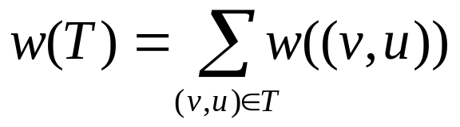
MST-Algorithms
Input: A weighted connected graph G = (V,E) with n vertices
and m edges
Output: A minimum- spanning tree T

Slide 17
Kruskal‘s Algorithm
Each vertex is in its own cluster
2. Take the edge e with the smallest weight
- if e connects two vertices in different clusters,
then e is added to the MST and the two clusters,
which are connected by e, are merged into a single cluster
- if e connects two vertices, which are already in the same
cluster, ignore it
3. Continue until n-1 edges were selected

Slide 18
5
A
B
4
6
2
C
2
D
3
3
1
2
E
F
4

Slide 19
5
A
B
4
6
2
C
2
D
3
3
1
2
E
F
4

Slide 20
5
A
B
4
6
2
C
2
D
3
3
1
2
E
F
4

Slide 21
5
A
B
4
6
2
C
2
D
3
3
1
2
E
F
4

Slide 22
5
A
B
4
6
2
C
2
D
3
3
1
2
E
F
4

Slide 23
5
A
B
4
6
2
C
2
D
3
cycle!!
3
1
2
E
F
4

Slide 24
5
A
B
4
6
2
C
2
D
3
3
1
2
E
F
4

Slide 25
5
A
B
4
6
2
C
2
D
3
3
1
2
E
F
4

Slide 26
minimum- spanning tree
A
B
2
C
2
D
3
1
2
E
F

Slide 27
Kruskal’s Algorithm
Run the algorithm:
Kruskal()
{
T = ∅;
for each v ∈ V
MakeSet(v);
sort E by increasing edge weight w
for each (u,v) ∈ E (in sorted order)
if FindSet(u) ≠ FindSet(v)
T = T U {{u,v}};
Union(FindSet(u), FindSet(v));
}
2
19
9
14
17
8
25
5
21
13
1

Slide 28
Kruskal’s Algorithm
Run the algorithm:
Kruskal()
{
T = ∅;
for each v ∈ V
MakeSet(v);
sort E by increasing edge weight w
for each (u,v) ∈ E (in sorted order)
if FindSet(u) ≠ FindSet(v)
T = T U {{u,v}};
Union(FindSet(u), FindSet(v));
}
2
19
9
14
17
8
25
5
21
13
1

Slide 29
Kruskal’s Algorithm
Run the algorithm:
Kruskal()
{
T = ∅;
for each v ∈ V
MakeSet(v);
sort E by increasing edge weight w
for each (u,v) ∈ E (in sorted order)
if FindSet(u) ≠ FindSet(v)
T = T U {{u,v}};
Union(FindSet(u), FindSet(v));
}
2
19
9
14
17
8
25
5
21
13
1

Slide 30
Kruskal’s Algorithm
Run the algorithm:
Kruskal()
{
T = ∅;
for each v ∈ V
MakeSet(v);
sort E by increasing edge weight w
for each (u,v) ∈ E (in sorted order)
if FindSet(u) ≠ FindSet(v)
T = T U {{u,v}};
Union(FindSet(u), FindSet(v));
}
2
19
9
14
17
8
25
5
21
13
1?

Slide 31
Kruskal’s Algorithm
Run the algorithm:
Kruskal()
{
T = ∅;
for each v ∈ V
MakeSet(v);
sort E by increasing edge weight w
for each (u,v) ∈ E (in sorted order)
if FindSet(u) ≠ FindSet(v)
T = T U {{u,v}};
Union(FindSet(u), FindSet(v));
}
2
19
9
14
17
8
25
5
21
13
1

Slide 32
Kruskal’s Algorithm
Run the algorithm:
Kruskal()
{
T = ∅;
for each v ∈ V
MakeSet(v);
sort E by increasing edge weight w
for each (u,v) ∈ E (in sorted order)
if FindSet(u) ≠ FindSet(v)
T = T U {{u,v}};
Union(FindSet(u), FindSet(v));
}
2?
19
9
14
17
8
25
5
21
13
1

Slide 33
Kruskal’s Algorithm
Run the algorithm:
Kruskal()
{
T = ∅;
for each v ∈ V
MakeSet(v);
sort E by increasing edge weight w
for each (u,v) ∈ E (in sorted order)
if FindSet(u) ≠ FindSet(v)
T = T U {{u,v}};
Union(FindSet(u), FindSet(v));
}
2
19
9
14
17
8
25
5
21
13
1

Slide 34
Kruskal’s Algorithm
Run the algorithm:
Kruskal()
{
T = ∅;
for each v ∈ V
MakeSet(v);
sort E by increasing edge weight w
for each (u,v) ∈ E (in sorted order)
if FindSet(u) ≠ FindSet(v)
T = T U {{u,v}};
Union(FindSet(u), FindSet(v));
}
2
19
9
14
17
8
25
5?
21
13
1

Slide 35
Kruskal’s Algorithm
Run the algorithm:
Kruskal()
{
T = ∅;
for each v ∈ V
MakeSet(v);
sort E by increasing edge weight w
for each (u,v) ∈ E (in sorted order)
if FindSet(u) ≠ FindSet(v)
T = T U {{u,v}};
Union(FindSet(u), FindSet(v));
}
2
19
9
14
17
8
25
5
21
13
1

Slide 36
Kruskal’s Algorithm
Run the algorithm:
Kruskal()
{
T = ∅;
for each v ∈ V
MakeSet(v);
sort E by increasing edge weight w
for each (u,v) ∈ E (in sorted order)
if FindSet(u) ≠ FindSet(v)
T = T U {{u,v}};
Union(FindSet(u), FindSet(v));
}
2
19
9
14
17
8?
25
5
21
13
1

Slide 37
Kruskal’s Algorithm
Run the algorithm:
Kruskal()
{
T = ∅;
for each v ∈ V
MakeSet(v);
sort E by increasing edge weight w
for each (u,v) ∈ E (in sorted order)
if FindSet(u) ≠ FindSet(v)
T = T U {{u,v}};
Union(FindSet(u), FindSet(v));
}
2
19
9
14
17
8
25
5
21
13
1

Slide 38
Kruskal’s Algorithm
Run the algorithm:
Kruskal()
{
T = ∅;
for each v ∈ V
MakeSet(v);
sort E by increasing edge weight w
for each (u,v) ∈ E (in sorted order)
if FindSet(u) ≠ FindSet(v)
T = T U {{u,v}};
Union(FindSet(u), FindSet(v));
}
2
19
9?
14
17
8
25
5
21
13
1

Slide 39
Kruskal’s Algorithm
Run the algorithm:
Kruskal()
{
T = ∅;
for each v ∈ V
MakeSet(v);
sort E by increasing edge weight w
for each (u,v) ∈ E (in sorted order)
if FindSet(u) ≠ FindSet(v)
T = T U {{u,v}};
Union(FindSet(u), FindSet(v));
}
2
19
9
14
17
8
25
5
21
13
1

Slide 40
Kruskal’s Algorithm
Run the algorithm:
Kruskal()
{
T = ∅;
for each v ∈ V
MakeSet(v);
sort E by increasing edge weight w
for each (u,v) ∈ E (in sorted order)
if FindSet(u) ≠ FindSet(v)
T = T U {{u,v}};
Union(FindSet(u), FindSet(v));
}
2
19
9
14
17
8
25
5
21
13?
1

Slide 41
Kruskal’s Algorithm
Run the algorithm:
Kruskal()
{
T = ∅;
for each v ∈ V
MakeSet(v);
sort E by increasing edge weight w
for each (u,v) ∈ E (in sorted order)
if FindSet(u) ≠ FindSet(v)
T = T U {{u,v}};
Union(FindSet(u), FindSet(v));
}
2
19
9
14
17
8
25
5
21
13
1

Slide 42
Kruskal’s Algorithm
Run the algorithm:
Kruskal()
{
T = ∅;
for each v ∈ V
MakeSet(v);
sort E by increasing edge weight w
for each (u,v) ∈ E (in sorted order)
if FindSet(u) ≠ FindSet(v)
T = T U {{u,v}};
Union(FindSet(u), FindSet(v));
}
2
19
9
14?
17
8
25
5
21
13
1

Slide 43
Kruskal’s Algorithm
Run the algorithm:
Kruskal()
{
T = ∅;
for each v ∈ V
MakeSet(v);
sort E by increasing edge weight w
for each (u,v) ∈ E (in sorted order)
if FindSet(u) ≠ FindSet(v)
T = T U {{u,v}};
Union(FindSet(u), FindSet(v));
}
2
19
9
14
17
8
25
5
21
13
1

Slide 44
Kruskal’s Algorithm
Run the algorithm:
Kruskal()
{
T = ∅;
for each v ∈ V
MakeSet(v);
sort E by increasing edge weight w
for each (u,v) ∈ E (in sorted order)
if FindSet(u) ≠ FindSet(v)
T = T U {{u,v}};
Union(FindSet(u), FindSet(v));
}
2
19
9
14
17?
8
25
5
21
13
1

Slide 45
Kruskal’s Algorithm
Run the algorithm:
Kruskal()
{
T = ∅;
for each v ∈ V
MakeSet(v);
sort E by increasing edge weight w
for each (u,v) ∈ E (in sorted order)
if FindSet(u) ≠ FindSet(v)
T = T U {{u,v}};
Union(FindSet(u), FindSet(v));
}
2
19?
9
14
17
8
25
5
21
13
1

Slide 46
Kruskal’s Algorithm
Run the algorithm:
Kruskal()
{
T = ∅;
for each v ∈ V
MakeSet(v);
sort E by increasing edge weight w
for each (u,v) ∈ E (in sorted order)
if FindSet(u) ≠ FindSet(v)
T = T U {{u,v}};
Union(FindSet(u), FindSet(v));
}
2
19
9
14
17
8
25
5
21?
13
1

Slide 47
Kruskal’s Algorithm
Run the algorithm:
Kruskal()
{
T = ∅;
for each v ∈ V
MakeSet(v);
sort E by increasing edge weight w
for each (u,v) ∈ E (in sorted order)
if FindSet(u) ≠ FindSet(v)
T = T U {{u,v}};
Union(FindSet(u), FindSet(v));
}
2
19
9
14
17
8
25?
5
21
13
1

Slide 48
Kruskal’s Algorithm
Run the algorithm:
Kruskal()
{
T = ∅;
for each v ∈ V
MakeSet(v);
sort E by increasing edge weight w
for each (u,v) ∈ E (in sorted order)
if FindSet(u) ≠ FindSet(v)
T = T U {{u,v}};
Union(FindSet(u), FindSet(v));
}
2
19
9
14
17
8
25
5
21
13
1

Slide 49
Kruskal’s Algorithm
Run the algorithm:
Kruskal()
{
T = ∅;
for each v ∈ V
MakeSet(v);
sort E by increasing edge weight w
for each (u,v) ∈ E (in sorted order)
if FindSet(u) ≠ FindSet(v)
T = T U {{u,v}};
Union(FindSet(u), FindSet(v));
}
2
19
9
14
17
8
25
5
21
13
1

Slide 50
Prim‘s Algorithm
All vertices are marked as not visited
2. Any vertex v you like is chosen as starting vertex and
is marked as visited (define a cluster C)
The smallest- weighted edge e = (v,u), which connects
one vertex v inside the cluster C with another vertex u outside
of C, is chosen and is added to the MST.
4. The process is repeated until a spanning tree is formed

Slide 51
5
A
B
4
6
2
C
2
D
3
3
1
2
E
F
4

Slide 52
5
A
B
4
6
2
C
2
D
3
3
1
2
E
F
4

Slide 53
5
A
B
4
6
2
C
2
D
3
3
1
2
E
F
4

Slide 54
5
A
B
4
6
2
C
2
D
3
3
1
2
E
F
4

Slide 55
5
A
B
4
2
6
C
2
D
3
3
1
2
E
F
4

Slide 56
A
5
B
4
2
6
C
2
D
3
3
1
2
E
F
4

Slide 57
5
A
B
4
2
6
C
2
D
3
3
1
2
E
F
4

Slide 58
A
5
B
4
2
6
C
2
D
3
3
1
2
E
F
4

Slide 59
minimum- spanning tree
A
B
2
C
2
D
3
1
2
E
F

